Slide 1
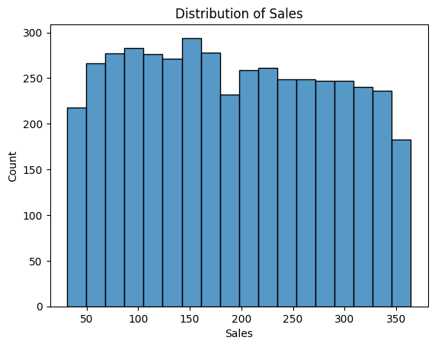
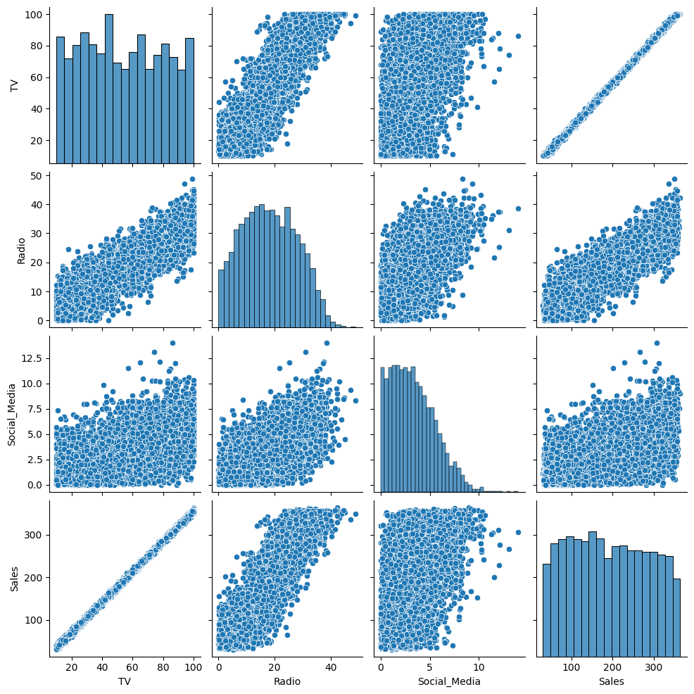
Simple Linear Regression Analysis Executive Summary Report Prepared by Robes Fokoueng – March 2024
Project Overview
We want to explore the relationship between different marketing promotional budgets and sales. This will help the leaders to make decisions about where to focus future marketing effort.
Key Insights
Among TV, social media, and radio, TV had the strongest positive linear relationship with sales.
The linear regression model estimates that 99.9% of the variation in sales is explained by the TV promotional budget. In other words, nearly all the variation in sales can be explained by the TV promotional budget alone, making TV an excellent predictor of sales.
According to the model, when TV is used as the independent variable X, an increase of one million dollars for the TV promotional budget would result in an estimated 3.5614 million more dollars in sales.
The interval (3.558 million, 3.565 million) has a 95% probability of containing the true estimate of the increase in sales for a one million dollar increase in the TV promotional budget.
Details
Sales is relatively equally distributed between $25 and $350 million across all promotions.
TV has the strongest linear relationship with sales.
Recommendations
Of the three available promotion types (TV, radio, and social media), TV has the strongest positive linear relationship with sales. According to the model, an increase of one million dollars for the TV promotional budget will result in an estimated 3.5614 million dollars more in sales. This is a very confident estimate, as the p-value for this coefficient estimate is small. Thus, the business should prioritize increasing the TV promotional budget over the radio and social media promotional budgets to increase sales.
Next Steps
Providing the business with the estimated sales given different TV promotional budgets
Using both TV and Radio as independent variables.

